Slide 1
ATTENDANCE MARKER
-CODE GEASSERS

Slide 2
PROBLEM
During the pandemic time,educationnal institutions conduct class using G-Meet.But when there is an online class,some students may have net issues and may lost their attendance.

Slide 3
SOLUTION
To solve this problem we have came with an idea that is to create an extension which records the people who have entered and left the meet,at what time,and how long they had been there

Slide 4

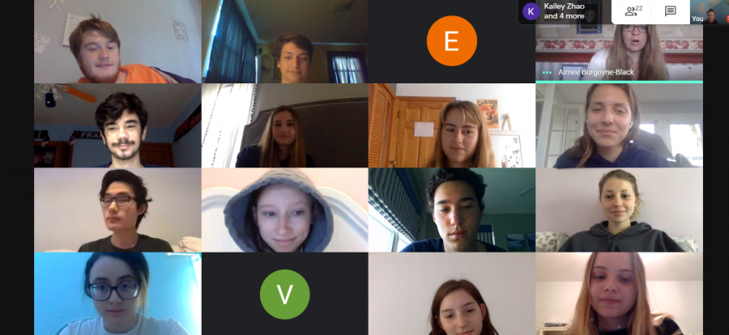

Slide 5
EXPECTED OUTPUT
Roll no | Name | Time entered | Time left | Total time spent
1 | Ananya | 9:01 am 9:33am | 9:30 am 9:50am | 46 minutes
2 | Basil | 9:00am | 9:50am | 50 minutes
3 | Carl | 9:22am | 9:45am | 23 minutes

Slide 6
PS:-We have no basic knowledge on html ,so we are only able to provide solution as a presentation.Sorry for the inconvenience.

